Slide 1
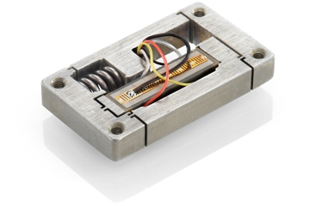
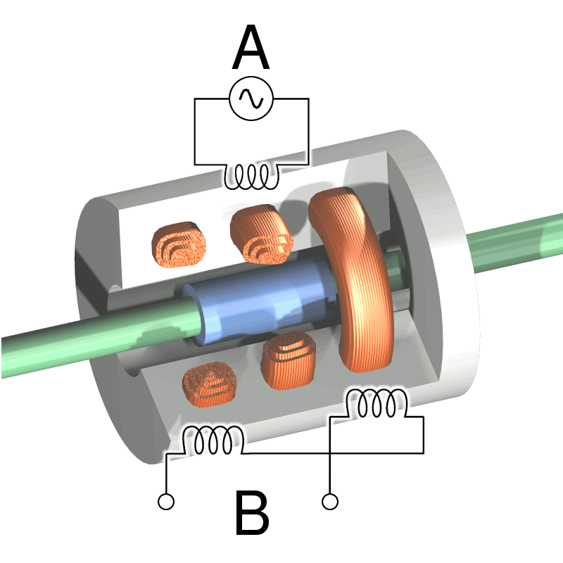
Sensors and Data
Piezoelectric Actuator Lab
Used a motor with a fine travel range of 25 micrometers
Inputted 5 V signal at 5hz
Measured movement with Linear Variable Displacement Transducer (LVDT) and National Instruments LabView
Used filters to account for noise
Looked for 5hz signal in LabView

